Slide 1

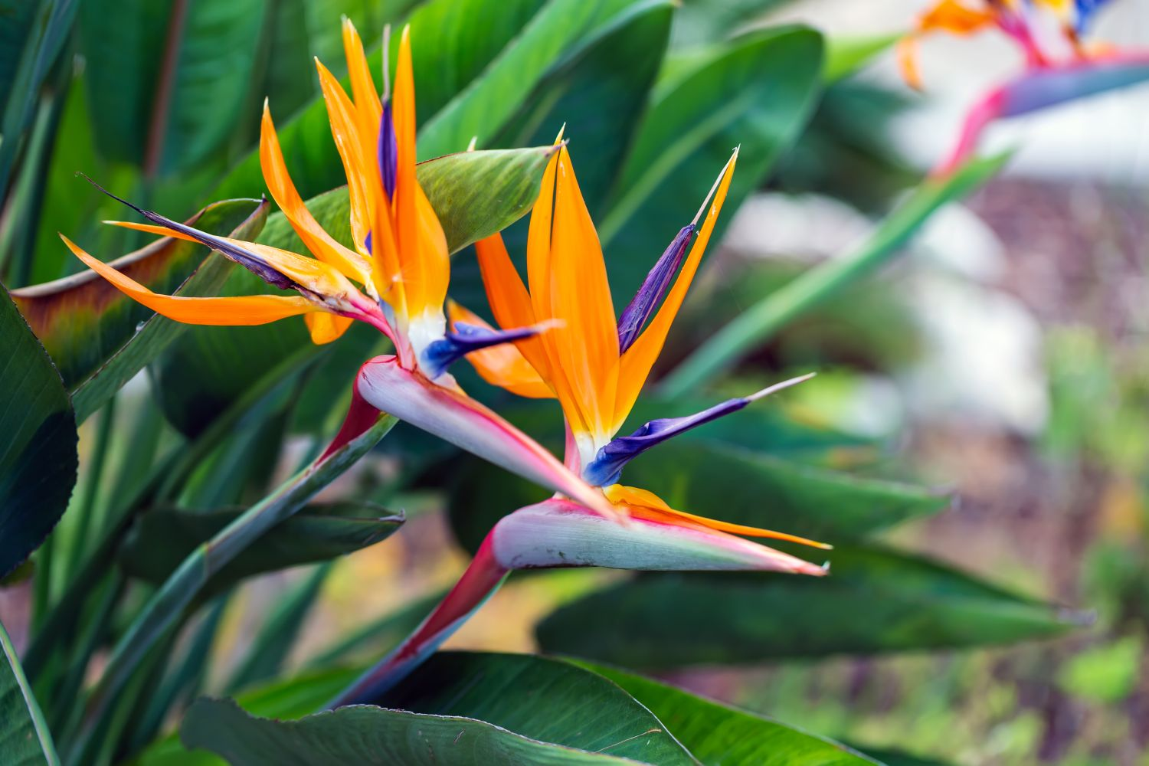
Bharati Vidyapeeth (Deemed To Be University)
Rajiv Gandhi Institute of IT and Biotechnology
Bird of Paradise
PRESENTED BY:
ANITA CHOUDHARY (09)
GAURI LONDHE (22)
B.Sc. BIOTECHNOLOGY
THIRD YEAR (SEM V)

Slide 2
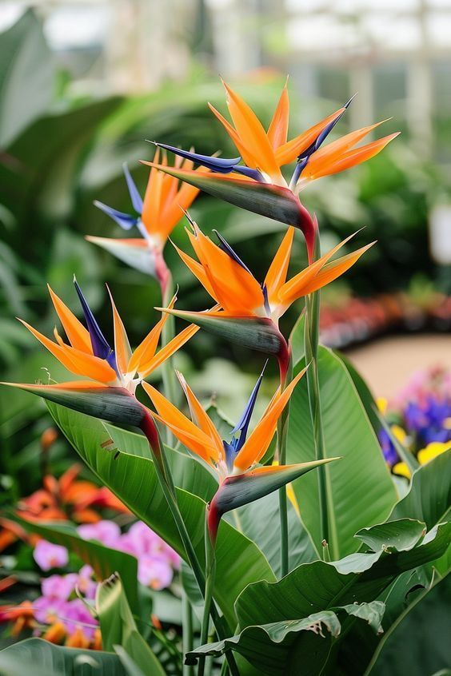
INTRODUCTION:
Bird-of-paradise or crane flower (Strelitzia reginae) is a native of South Africa and is closely related to the banana.
The genus Strelitzia belongs to the family Strelitziaceae
The herbaceous plant derives its common names from the unique flower it bears, which resembles a brightly colored bird in flight. That’s why it’s called “Bird of Paradise.”
The evergreen leaves of bird-of-paradise do not drop from the plant, which makes it an excellent addition around pools or wherever shedding leaves are an aesthetic or maintenance problem.
https://edis.ifas.ufl.edu/publication/MG106

Slide 3
2. CLIMATE:
Prefers warm, tropical to subtropical climates.
Ideal temperature: 18–30°C.
Cannot tolerate frost; needs protection in cold climates.
Needs sunlight for good flowering, but can also grow in light shade.
3. SOIL
Needs well-drained soil (water should not collect).
pH: 5.5–7.5 (slightly acidic to neutral).
Rich in organic matter (Fertile Soil)
Avoid waterlogging (accumulation of access water in the soil, often leads to saturation and hindering plant growth) .

Slide 4
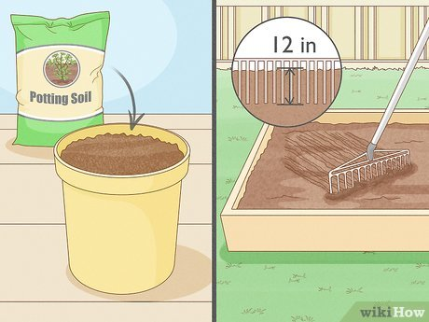
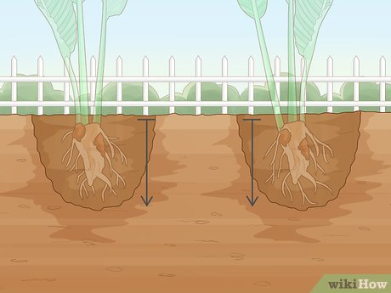
4. BED PREPARATION
Prepare raised beds especially in heavy soils.
Mark the area: Top width: 90cm
Bottom: 100cm
Height: 45cm
Path: 50cm
Loosen soil to a depth of 45–60 cm deep so roots grow well.
Mix compost or cow dung manure to improve soil.

Slide 5
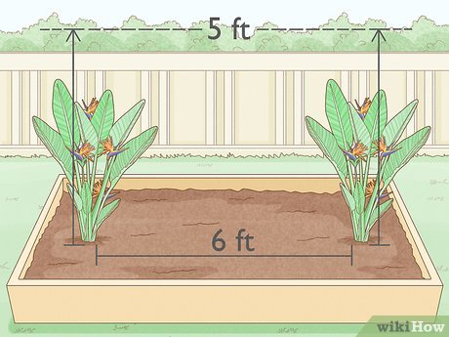
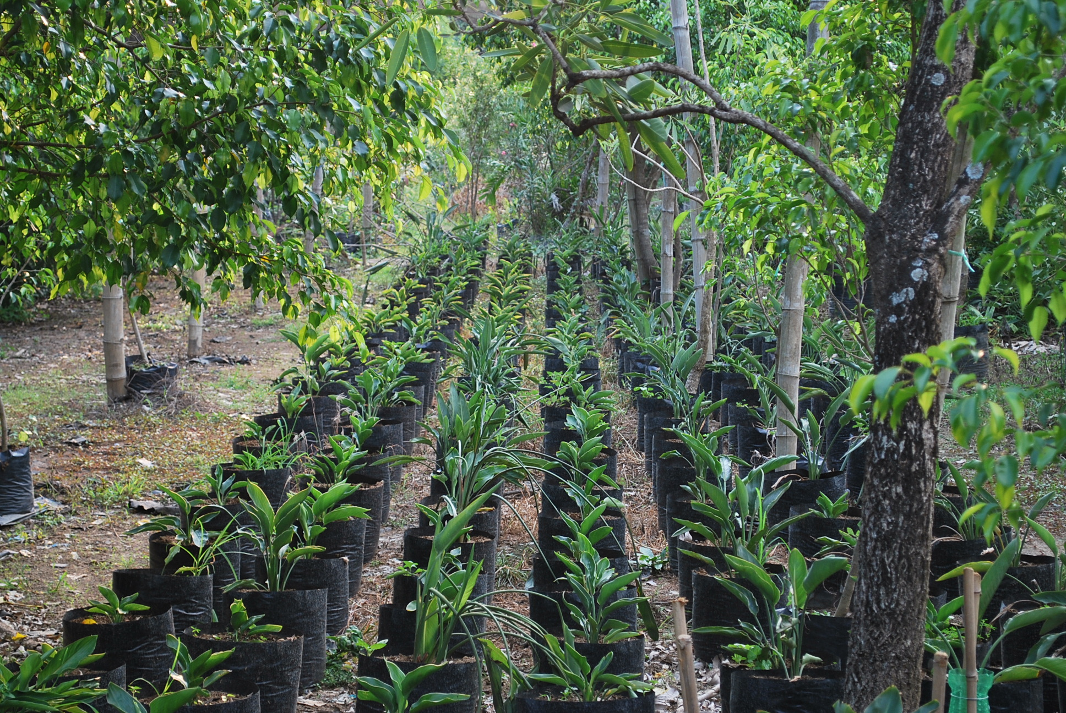
5. PLANTING DISTANCE
Keep a gap of 60 to 90 cm between plants (Plant to Plant).
Between rows, leave 90 to 120 cm space (Row to Row).
Gives enough room for plant growth and air circulation.
It grows up to a height of 90 cm.
6. PLANTING MATERIAL
Can be grown by seeds or by dividing old plants (rhizomes).
Nursery pots, Indoor planting : Straight row
Landscaping, ornamental garden, Farm/field cultivation: Zigzag
Best time to plant: Spring season.

Slide 6
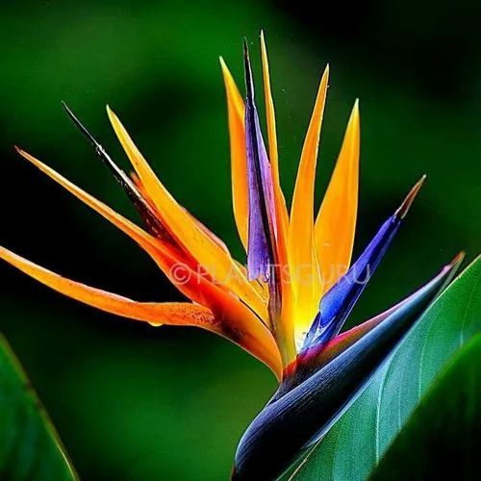
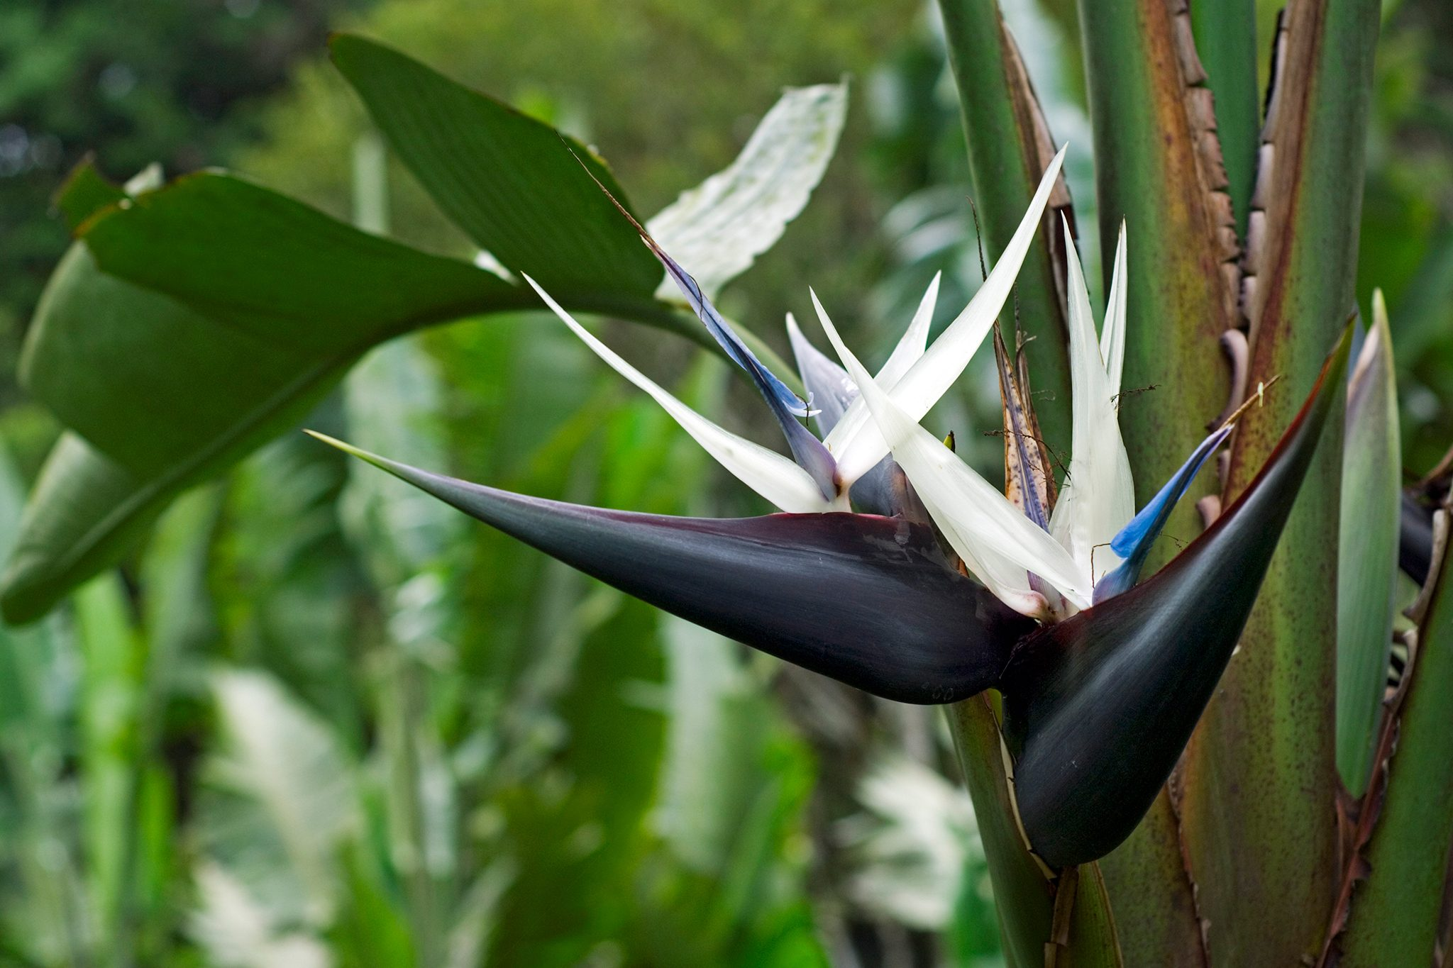
7. TYPES & VARIETIES:
The genus Strelitzia includes about five species. They are Sterlitzia nugusta, Sterlitzia reginae, Sterlitzia kewensis, Sterlitzia nicolai, and Sterlitzia candida.
Strelitzia reginae is a very popular orange-flowered species and commonly known as the bird of paradise.
Strelitzia reginae: Orange and blue flower (most common).
Strelitzia nicolai: Larger plant with white and blue flowers (also called Giant Bird of Paradise).

Slide 7
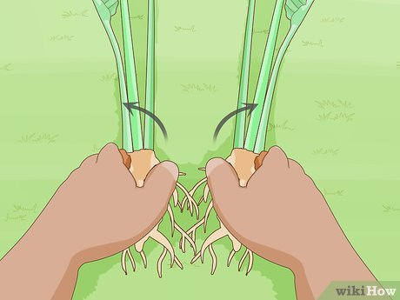
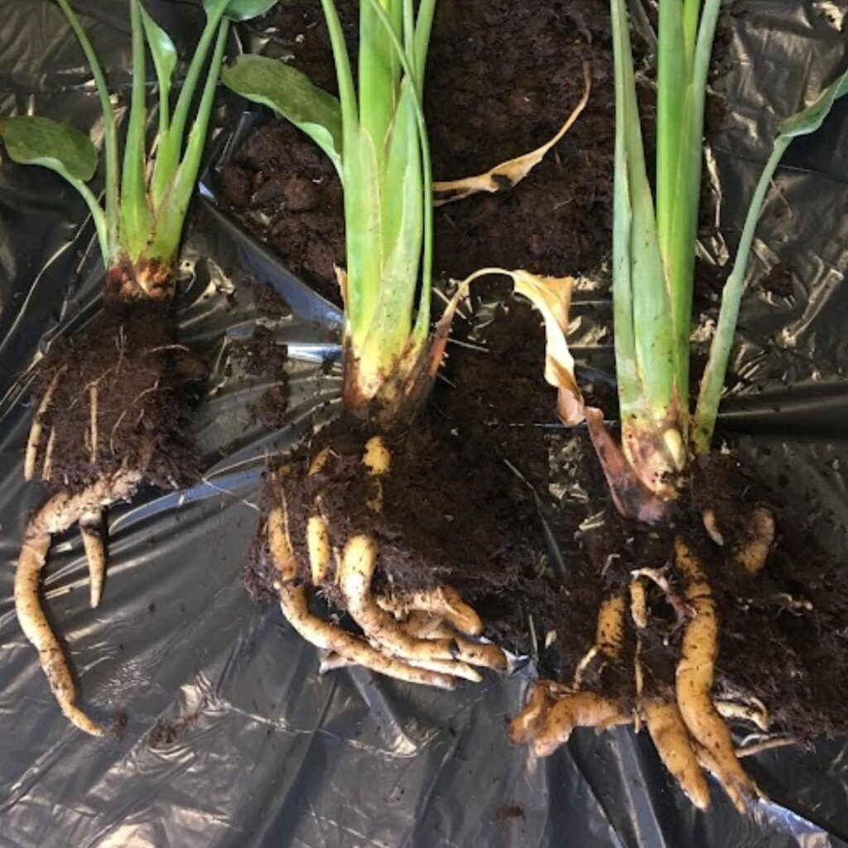
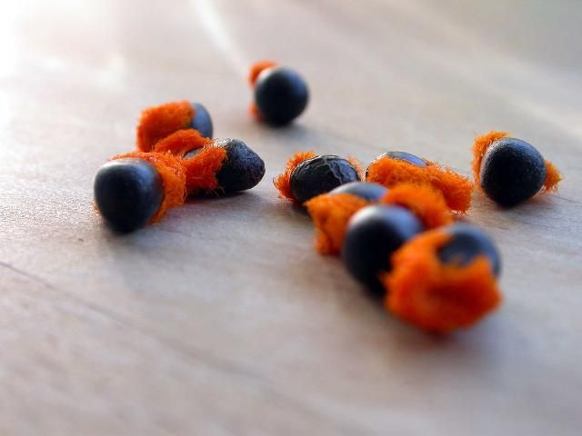
8. Cultivation Method for Bird of Paradise:
Site Selection:
Choose a sunny, frost-free location.
Protect the plant from strong winds.
Ideal temperature: 15°C to 30°C.
2. Soil Preparation:
Recommended mix: 1 part garden soil + 1 part compost + 1 part sand.
3. Propagation
You can propagate the plant by:
Division: Separate rhizomes from a mature plant (3–4 years old).
Seeds: Scarify and soak seeds for 24–48 hours. Sow in moist seed-starting mix.

Slide 8
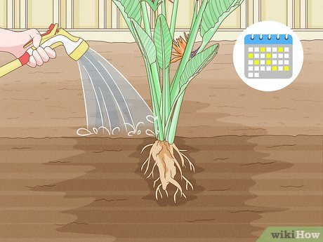
4. Planting:
Spacing: Keep 1 to 1.5 meters between plants.
Place rhizomes at soil surface level.
Water gently after planting.
5. Watering:
Keep soil consistently moist, but not waterlogged.
Let the surface dry slightly between waterings.
More water required in summer; reduce watering during winter dormancy

Slide 9
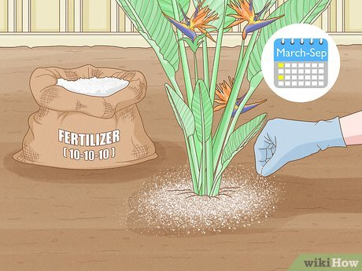
6. MANURE & FERTILIZERS:
Basal dose: Mix 10–15 kg of cow dung (FYM) at planting.
Use NPK fertilizer in the ratio 10:10:10 every 6–8 weeks for active growth.
Micronutrients (Mg, Fe) can be added for vibrant foliage, help in healthy leaves , better leaf colour.

Slide 10
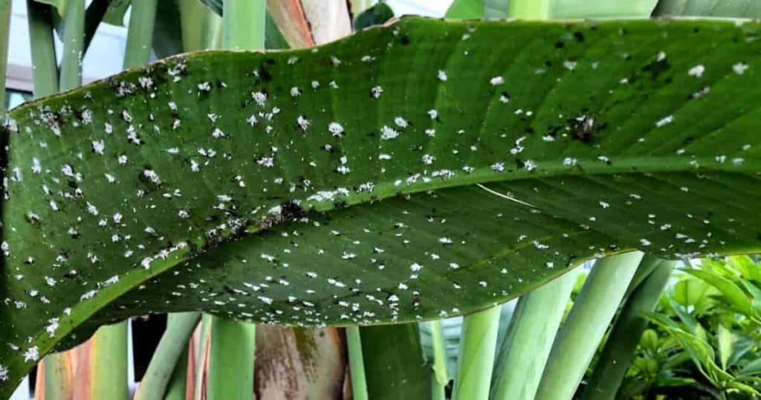
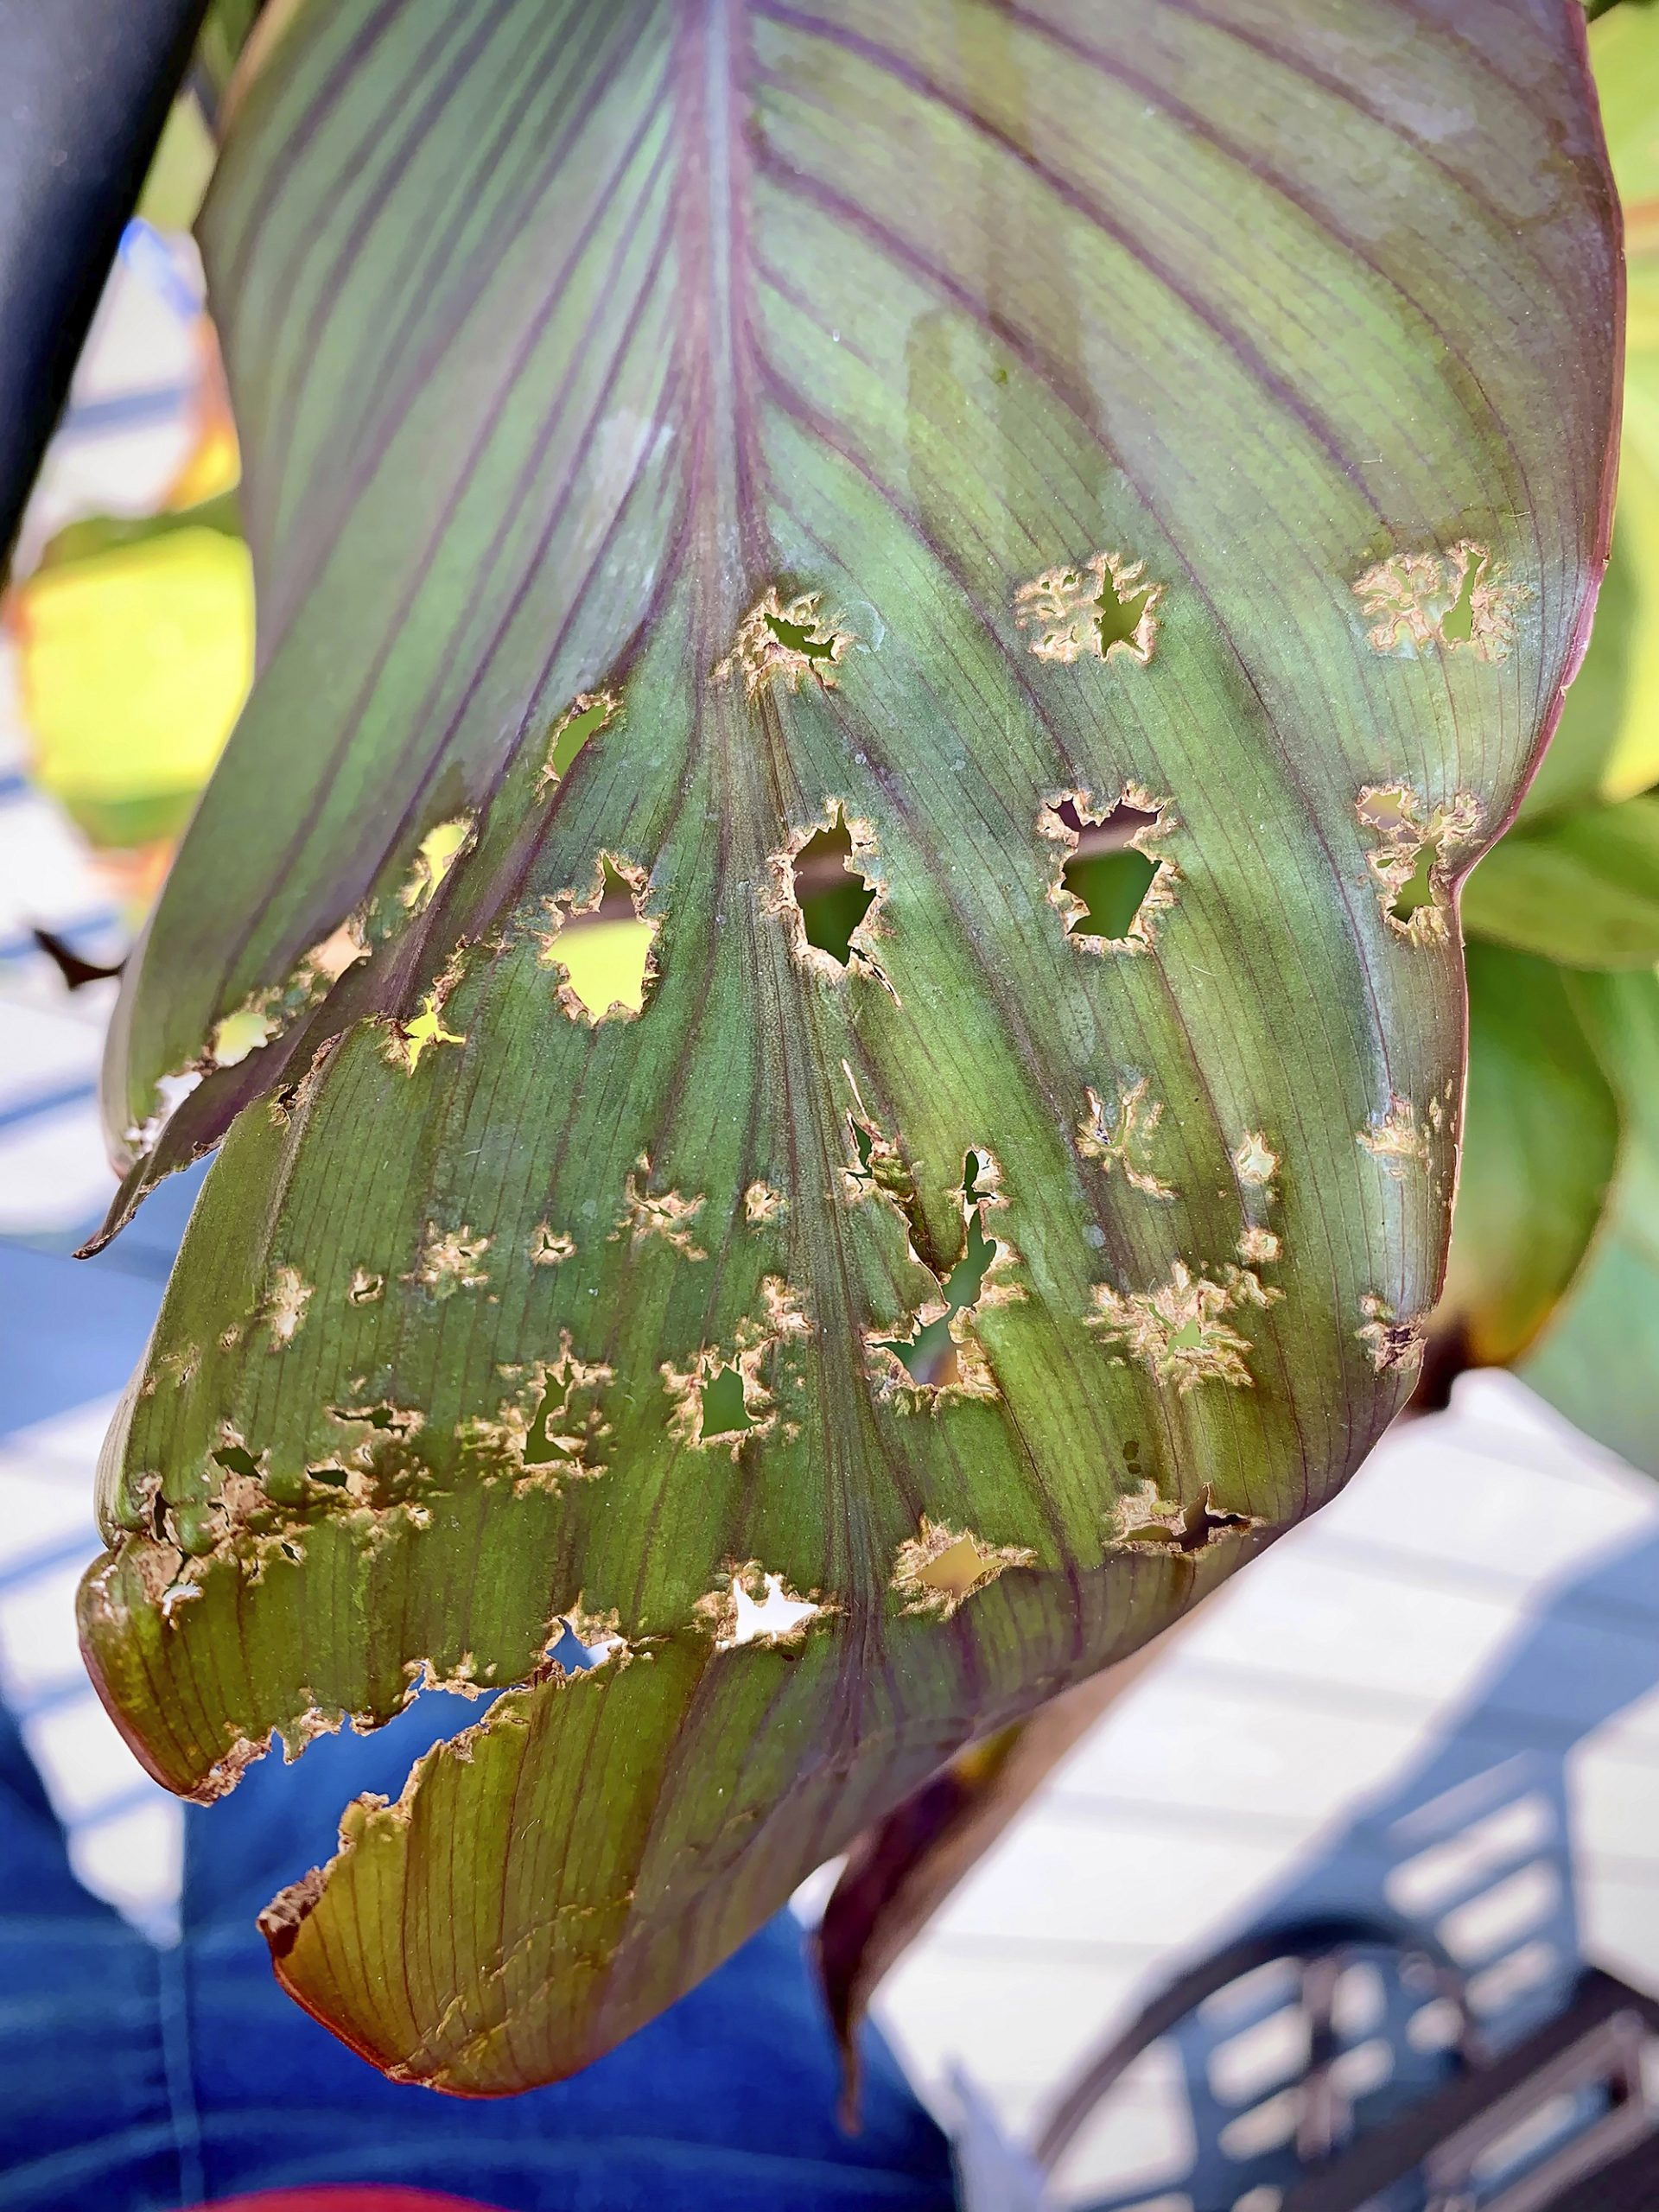
7. PEST & DISEASES:
Diseases: Root rot (due to poor drainage), fungal spots on leaves, Powdery Mildew, Bacterial Leaf Spot.
Pests: Mealybugs, spider mites, aphids, Scale Insects.
Pathogens: Xanthomonas spp.
Control: Use neem oil or use mild pesticides if needed. Maintain hygiene and airflow.

Slide 11
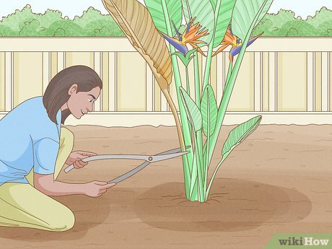
8. HARVESTING
Flowers are harvested (Cut) when the first petal begins to open.
A healthy plant can give 12 to 36 flowers per year, but it takes 3–5 years to start flowering properly.
Flowers last a long time and are good for decoration.
9. CULTIVATION AREAS:
In India, Bird of Paradise is grown in sub-temperate and sub-tropical regions like Himachal Pradesh, Kalimpong and Darjeeling in West Bengal, Nilgiri hills and the Western Ghats, Bangalore and adjoining areas in Karnataka, etc.

Slide 12
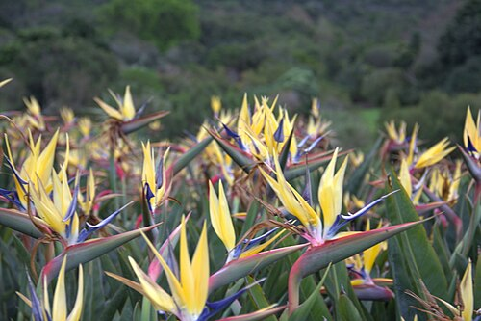
10. GRADING & PACKAGING:
Flowers are graded based on size, color, and freshness.
Pack carefully in upright boxes so flowers don’t get damaged.
Use soft materials to protect delicate bracts during transit.

Slide 13
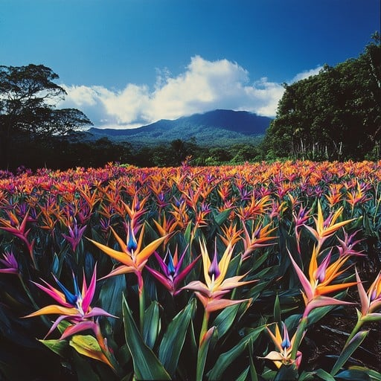

Slide 14
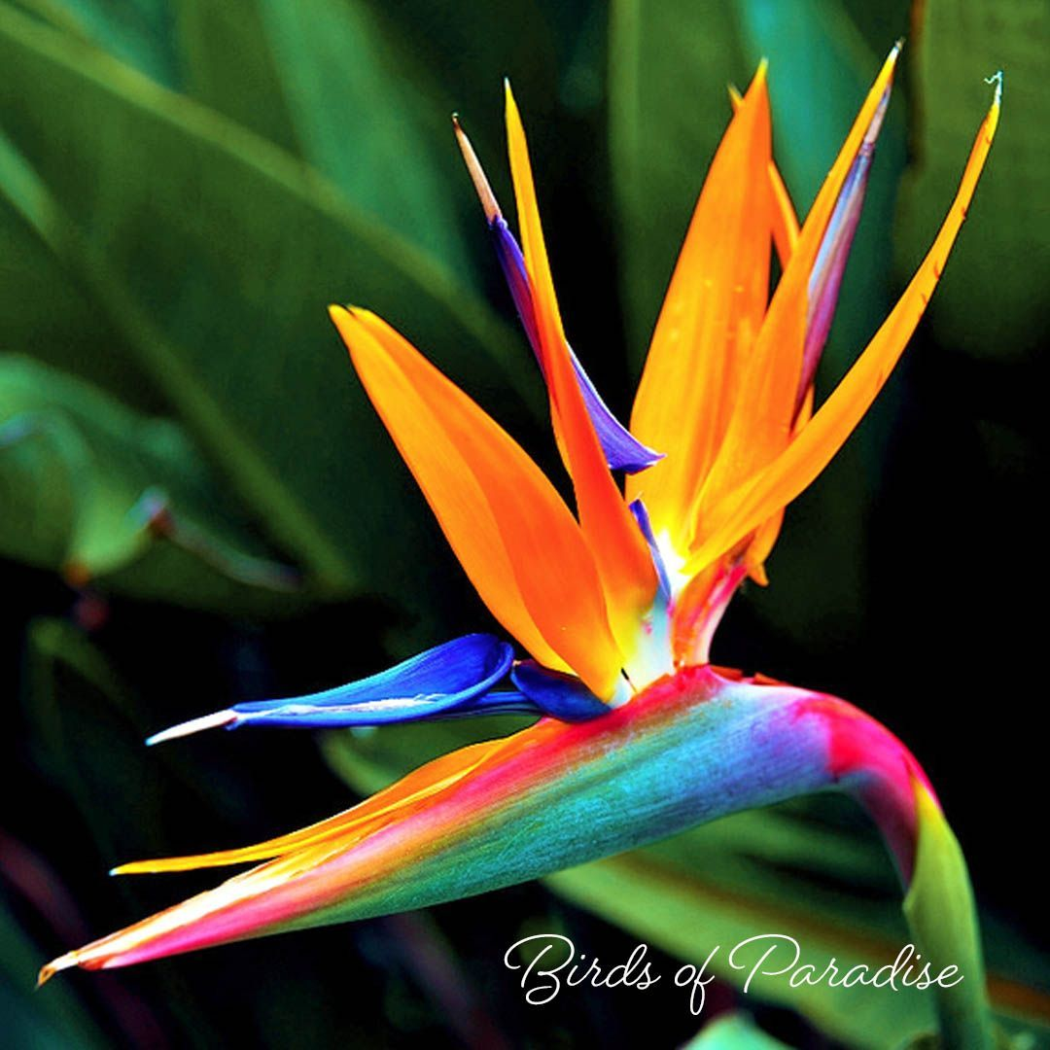
THANK
YOU

